Slide 1
Libraries
Scikit-Learn
TensorFlow
PyTorch

Slide 2

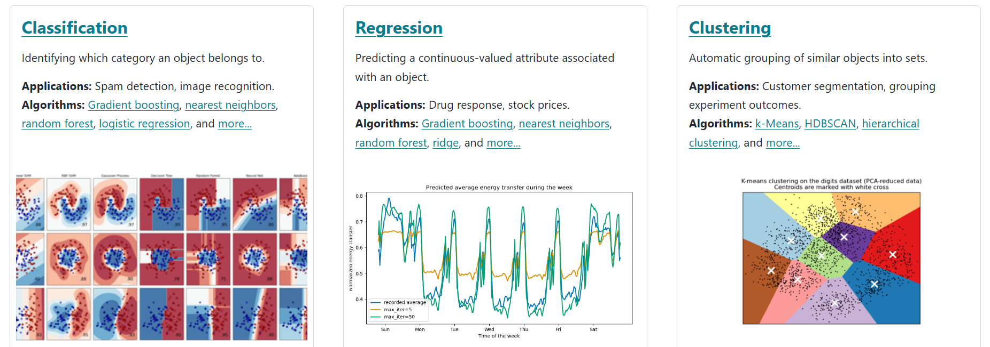
Scikit-Learn
Implements machine learning algorithms like regression, SVM, decision-trees, random-forest, PCA, etc.
Built upon basic numerical libraries such as Numpy, SciPy, and Matplotlib
Uses simple APIs like fit(), predict(), transform()
When to use : Solving classical ML problems and for small datasets
Drawbacks : Not optimized for deep learning libraries
Reference : https://scikit-learn.org/stable/

Slide 3

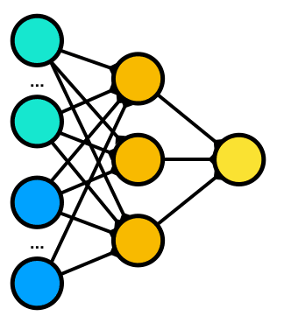
TensorFlow (Developed by google)
Framework for deep learning and numerical computation.
It is built using C++ libraries with support for GPUs by leveraging CUDA libraries
Provides two execution modes: Eager mode and Graph execution mode
Graph Mode (Static graph) (Tensoflow V1.x): Builds a computational graph first, where nodes are the operations and edges are tensors.
    Internally compile and run (more opportunity for code optimizations like operator fusion, parallelization, etc.)
    More like a C++ program (first compile and run)
  Eager Mode (Tensorflow V2.x) : Operations run immediately line by line, just like in normal Python
Keras is an abstract high-level API for TensorFlow
When to use: For large-scale training and building production pipelines
Drawbacks: Had to build the full computational graph before running, which makes it harder to experiment
Resources: https://www.tensorflow.org/

Slide 4
Static Graph
import tensorflow as tf
x = tf.placeholder(tf.float32)
y = tf.placeholder(tf.float32)
z = x + y
with tf.Session() as sess:
result = sess.run(z, feed_dict={x: 1, y: 2})
print(result) # 3

Slide 5
Eager Graph
import tensorflow as tf
x = tf.constant(1.0)
y = tf.constant(2.0)
print(x + y) # Runs immediately

Slide 6

PyTorch (Developed by Facebook AI Research - FAIR)
Dynamic computation graph : Graphs built on the fly (line-by-line execution)
  Strong ecosystem for transformers, computer vision, and generative AI
  Prefer TensorFlow for deployments and PyTorch for experimentations
Core components of PyTorch includes :
  Tensors : Vectors in 1D, Matrices in 2D, Tensors in 3D and all of these can be generalized as tensors
  Autograd : built-in gradient calculation functionality for PyTorch Tensors.
  nn.Module : Base class for all models
  Optimizers : Support for different kinds of Deep learning optimizers like Adam, SGD, etc.
Supports different kinds of distributed training techniques like Dataparallel, Modelparallem, etc.
When to use : Research & Experimentation with models
Resource : https://pytorch.org/

Slide 7
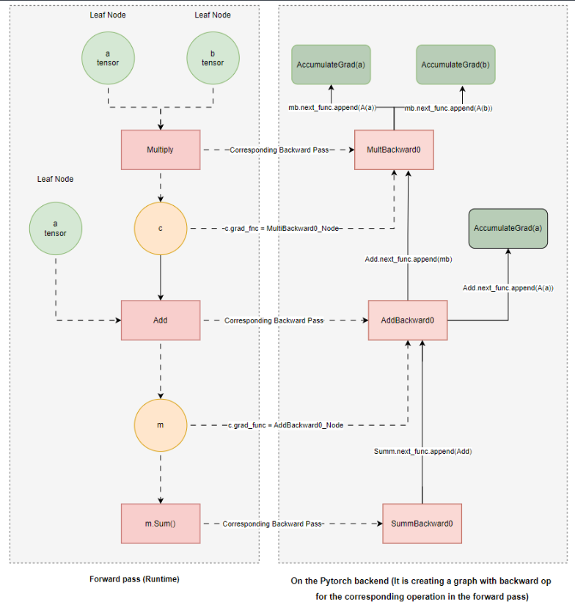
What’s special about PyTorch ?
Built in gradients for each tensors
  Makes the life of the programmer easier
  Easy to track.
Dynamic graph computation
  Easy to experiment and debug
What does dynamic graph creation means ?
In deep learning, there are two phases of training :
  Forward pass
  Backward pass
PyTorch dynamically creates operations for backward pass while executing the forward pass operations.
The diagram illustrates the operation :
m = a * b + c

Slide 8
ONNX
Provides interoperability between different ML frameworks.
Train in one framework (e.g., PyTorch, TensorFlow) → Deploy in another (e.g., Caffe2, ONNX Runtime).
Enables model portability across platforms, tools, and devices.
Supported by major hardware vendors (NVIDIA, Intel, AMD).
Optimized runtime for inferenceSupport for edge devices, cloud, and HPC

